Slide 1

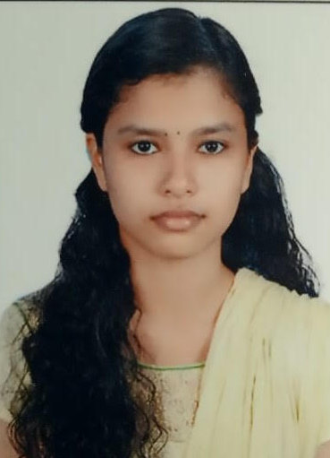


Indu K V
Education and certificates
Bachelor of Technology
Computer Science : 2017 –2021
PHP, JavaScript, CSS, HTML fundamentals course certifications from Sololearn.
Completed Architecting with Google Computer Engine Specialization in Coursera.
Analyst/Software Engineer
Base Location: Bangalore
Email ID:
indu.k-v@capgemini.com
_{Mobile No: 8136943170}
Grade:
A4
Skills
C++
Python
JavaScript
Strengths
Innovative and enthusiastic learner with a passion for critical thinking and problem solving.
Quick leaner with SQL/PLSQL knowledge . Working hard to expand and utilize skills and knowledge.
Flexible to work in any environment as required and an excellent team player with good communication skill.
Inquisitiveness and urge to learn more and new skills.
Achivement
Suicide Prediction model using Deep Learning
Backend
Oracle
MongoDB
A deep learning based method, which classifies tweets into suicide positive and negative. The project is based on analysing the twitter dataset and detecting the suicidal tendencies in tweets.
Database
SQL database – Oracle
No SQL database – MongoDB
RDBMS Mini Project on Broad-Band Billing system
Web Technologies
HTML5 CSS3
Javascript
Designed and implemented database, reports for subscription plans, billing, transaction details etc.
AddOns Github
Visual Studio
Additional Details
Excellent Communication Skills
Team Player
Open to new ideas
Presentation Title | Author | Date © Capgemini 2017. All rights reserved | 1

